Slide 2
PRESENTATION
TO:
PRESENTED BY:
Dawsons Group of Companies
Notes:
Market Sectors

Slide 3
ABOUT DAWSONS
The Dawson’s Group of Companies is one of Queensland’s largest privately owned industrial services operations
Employing up to 400 base staff per year with scope for over 1000 employees depending on projects
With networks and remote sites across the country, the Groups head office and workshops are based in:
Cairns
Townsville
Mt Isa
Close to North Queensland mines and industrial growth zones.
Notes:
About Dawsons

Slide 4
Notes:
Dawsons Reach photo 1

Slide 5
Notes:
Dawsons Reach Photo 2

Slide 6
Notes:
Dawsons Reach Flash Map Australia Workshops first, then the Remote Sites

Slide 8
OUR VALUES
Our values underpin our internal recruitment process. They are
• Work Ethics. Uncompromising integrity, honesty, and dedication to deliver - “whatever it takes, whatever the size of the job, in whatever location”.
• Excellence. We set high standards. Thriving on challenge and accomplishment.
• Empowerment. Dawsons staff are empowered to make a difference and find lateral solutions when needed. Talent and creativity is never thwarted.
• Mutual Respect. We value an inclusive culture based on diverse backgrounds, experience, and views.
• Safety. Zero accidents - people’s lives depend on it.
Notes:
Our Values

Slide 9
SAFETY POLICY
Dawsons Group of Companies recognises its moral and legal responsibility to provide a safe and healthy workplace.
We develop, maintain and promote safe and productive work practices
We effectively manage risk in all aspects of our business
We believe that every accident, and therefore every injury, is preventable
Safety is always a top priority and a value that is fundamental to our organisation
Our employees have stop-work authorities that if it is not safe do not do it, and they are actively encouraged to use this authority.
Although each person’s actions will ultimately determine his or her own individual safety, there is a clear duty for all those charged with supervision and management to establish and implement safety priorities and procedures.
Notes:
Safety Policy

Slide 10
ENVIRONMENTAL STRATEGY
Dawsons Environmental Strategy
Our aim is to achieve a high standard of care for the natural environment in all of the activities in which we engage.
Dawsons Group of Companies approach to environmental management seeks continuous improvement in performance by taking account of evolving scientific knowledge and community values.
Notes:
Environmental Strategy

Slide 11
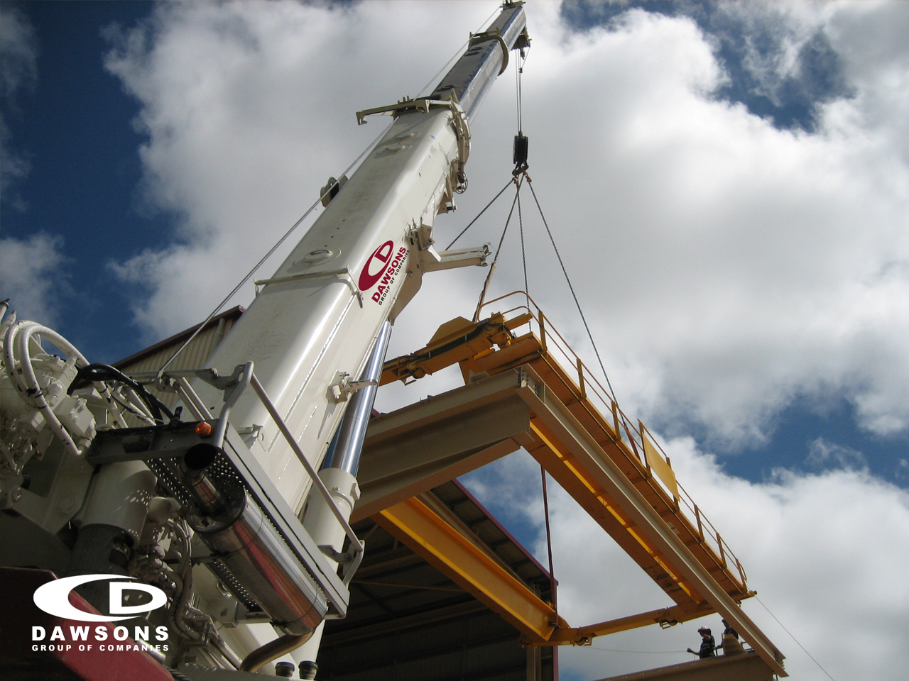
OUR VISION
To be Australia’s Leading Industrial Service Provider
- Australian Owned and Operated.
• Success is determined by long term relationship and alliances
• Invest in our staff and provide a platform to achieve results
• A responsible corporate citizen. Respecting Indigenous cultures. Supporting regional communities through sponsorship, expertise, training and mentoring programs.
The Dawson’s Group of Companies provides the Complete Industrial Solution.
Why go anywhere else?

Slide 12
THE DAWSONS DIFFERENCE
What makes Dawson’s stand out from the rest?
• Proven supplier
Dawsons has over 21 years experience in the mining and industrial sectors and holds maintenance contracts with many of the major mines in North West QLD and NT.
• Ability to adapt to change rapidly
We are dynamic and respond to market changes faster than most.
Notes:
The Dawsons Difference Slide 1

Slide 13
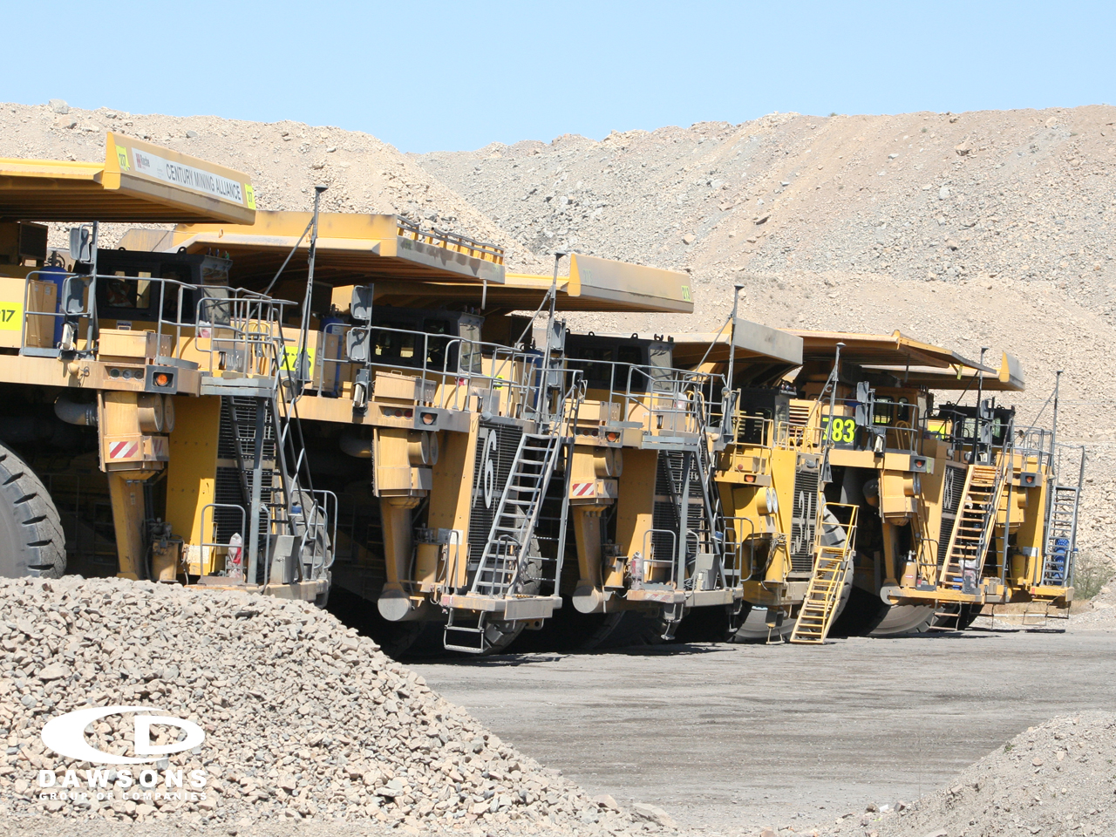
THE DAWSONS DIFFERENCE
• Leveraging off our divisions
Our strength lies in our own ability to leverage off the different divisions within the organisation. Additional projects in our workshops can be managed by utilising our own labour hire to meet deadlines.
• Culture of development and innovation
Employees are empowered and encouraged to solve problems and contribute to the final solutions. Dawsons embraces a culture of continuous improvement.

Slide 14
• Complete industrial services solution
We are the only local company that offers a full complement of industrial solutions.
Dawsons are able to manage the entire operation, from planning, implementation to ongoing maintenance. This means client contact and expectations can be better managed and the back end process is seamless.
Because we have 3 workshops, the ability to operate 24/7, and an unlimited pool of skilled tradespeople - our turnaround time is dramatically shortened.
Notes:
Stand Out Slide 1

Slide 15
• Our People
The Dawsons culture is one of success, hard work and pride.
Staff take ownership of the projects undertaken and the team spirit is clearly visible when you walk into an office or worksite.
Notes:
Stand Out Slide 2

Slide 16
Notes:
7 Star Division Slide 1

Slide 17
Notes:
7 Star Division Slide 2

Slide 18
Notes:
7 Star Division Slide 3

Slide 19
Notes:
7 Star Division Slide 4

Slide 20
Notes:
7 Star Division Slide 5

Slide 21
Notes:
7 Star Division Slide 6

Slide 22
Notes:
7 Star Division Slide 7

Slide 23
Notes:
7 Star Division Slide 8

Slide 24
Notes:
7 Star Division Slide 9

Slide 25
LABOUR HIRE DIVISION
The success of this division is due to 3 factors:
1. The quality of registered Dawsons labour staff on our database available for placement throughout Australia
2. The number of registrations – over 37,000 names in our database, tailored for the industries in which we work
3. The professionalism and enthusiasm of our Dawsons Labour Hire officers – with low turnover, our knowledge about the team on call is first rate
Notes:
Labour Hire Division 1

Slide 26
LABOUR HIRE DIVISION
Why are we leading edge in labour hire?
• On call 7 days a week with portable database access at all times
• Leverage off our Training Division. We have scope to upgrade experience level.
• Provide full spectrum of staff - Engineers to Maintenance Planners.
• We are flexible and work remotely.
• We believe in our staff – we use our own labour hire staff within the Dawsons workshops – in Cairns, Townsville and Mt Isa.
• We are service focused. Dawsons regularly mobilise shutdown crews of up to 120 men and can supply supervisors and tooling. Shutdowns are a speciality area in which we work.
Notes:
Labour Hire Division 2

Slide 27
ENGINEERING DIVISION
The Dawsons Advantage:
• We are able to leverage off our 3 purposely built engineering workshops in Cairns, Townsville and Mt Isa.
• With 4700m2 under roof and 8000m2 hard stand between Cairns and Townsville facilities - Output capability ranges from 60-80 tonne per week.
• We are able to control work flow and utilise “down time” in one workshop to meet deadlines for clients – projects can be shared between sites.
Notes:
Engineering 1

Slide 28
ENGINEERING DIVISION
• Our workshops are able to operate 24/7 to meet tight deadlines.
• We can mobilise a project workforce from across the company – ensure we have the best mix of available skills and ability on the project .
• Our ability to mobilise to any site, Australia wide, at short notice has resulted in the success of many remote maintenance, construction and installation projects.
Notes:
Engineering 2

Slide 29
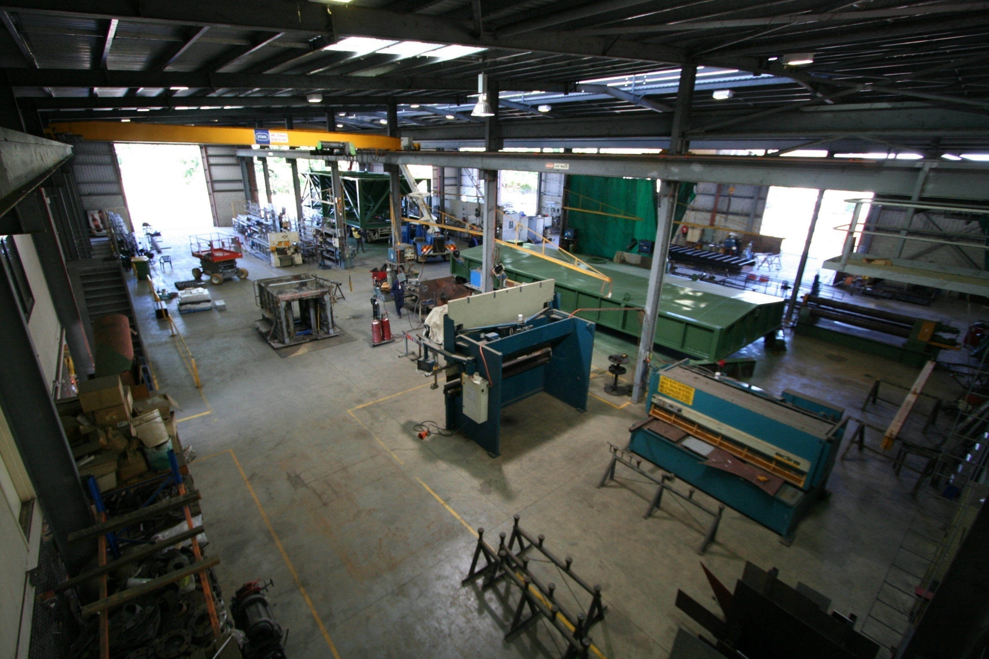

Slide 30
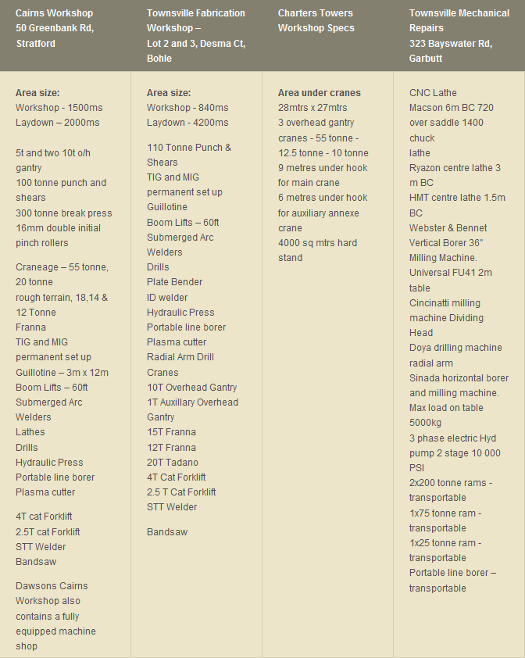

Slide 31
ASBESTOS & DEMOLITION
Dawsons Group is licensed by the Queensland Division of Workplace Health and Safety to carry out Asbestos Removal and Demolition projects.
Removal of friable asbestos-containing material
Bonded asbestos that is damaged or
More than 10 square metres in area
Must be carried out by licensed operators in accordance with the National Occupational Health & Safety Commission's Code of Practice for the Safe Removal of Asbestos.
All asbestos removal companies must be registered under relevant State or Territory legislation.
Notes:
Asbestos & Demolition

Slide 32
SAFE WORKING METHODS
Dawsons conduct a risk assessment in consultation with employees
A safe work procedure is then devised to minimises the release of dust and
fibres and avoid exposure
Specific safety precautions for work include:
1. Wearing protective clothing and an approved respirator
2. Use of non-powered hand tools as these generate less dust.
3. Wet working area if possible or use of vacuums fitted with High Efficiency Particulate Air (HEPA) filters.
4. Work in well-ventilated areas - Use drop sheets to collect debris.
5. Dispose of smaller asbestos pieces and collected dust in plastic bags, which are clearly labelled "asbestos waste".
Notes:
Safe Working Methods 1

Slide 33
POINT OF DIFFERENCE
Asbestos removal is dangerous and requires precision project management. The Dawsons specially qualified Asbestos removal team can work in any location not matter how remote.
Dawsons have a fully equipped mobile crew at the ready – turnaround time is very short
We have a proven track record with zero incident reports.
Safety is our first priority for our clients and our team.
We keep our team small, highly trained and limit the number of job work fronts – the quality of the operation is paramount.
Notes:
Point of Difference

Slide 34
WATERJET – Cutting Technology
One of the fastest growing major machine tool processes in the world
Versatile and easy to use
There are virtually no limits to what waterjets are capable of cutting and machining.
Dawsons can cut almost any material into virtually any shape and size.
- glass, steels, stainless steels and duplex alloys, rubber, ceramics, tile, wood, brass and copper, and cuts to tolerances of 0.02mm thanks to positioning sensors and onboard computers on the waterjet machine.
Dawsons Waterjet Division operates two state of the art Waterjet machines
-harnessing the cutting power of 4500 bar water pressure using CAD technology.
Notes:
Waterjet 1

Slide 35
WHY DAWSONS WATERJET?
• Advanced technology – an easy solution to a difficult problem
• Less risk than laser technology
No noxious gases or liquids are used in waterjet cutting, and waterjets do not create hazardous materials or vapours.
• No heat effected zones or mechanical stresses are left on a waterjet cut surface.
• Reduction in Material and Production Costs. Minimal fixturing and tooling to save time. Waterjets cut accurate, clean edges that allow for tight nesting and reduced scrap.
Notes:
Waterjet 2a

Slide 36
CONSTRUCTION DIVISION
Point of Difference:
Diverse scope - Ability to provide a quality construction solution for any client – public or private - from residential housing modifications to remote design and construction projects
Specialise in servicing remote locations throughout Australia. Teams works in environmentally sensitive, culturally significant and geographically remote locations.
Employ local indigenous labour, where possible
In fact, we will solve the problems associated with this work, when other companies cannot.
Notes:
Construction Division 1

Slide 37
CONSTRUCTION DIVISION
Notes:
Construction Division 2a

Slide 38
CONSTRUCTION DIVISION
Services include: | Project Examples:
Building Construction | DETA - Bamaga Teachers Accommodation Dawsons Workshops
New House – design and Construct | Private residential - Cairns
Building renovations and Maintenance | Dawsons office renovation, local businesses
Civil Works, Concreting, Earth Works | Red Bluff – Kuranda Rail Walkway Cannington & Century Mine Ergon – substation foundations
Notes:
Construction Division 2a

Slide 39
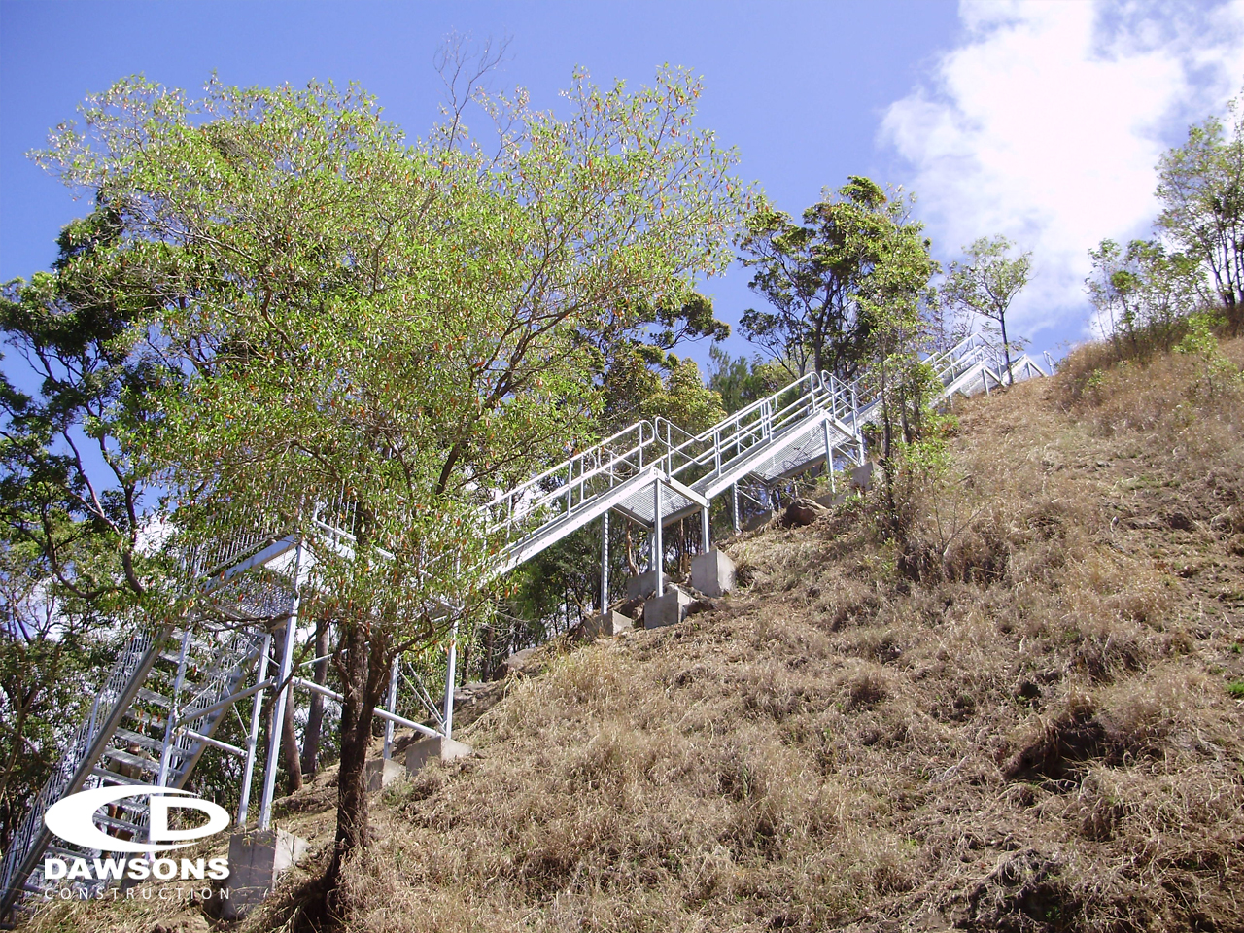
CONSTRUCTION DIVISION
Major Sectors:
Mining
Private
Government - local and state
Remote Indigenous Communities
Dawsons Construction Division prides itself on the personalised service and attention offered to clients.
Each client has access to a complete consulting package, managed by a Project Manager and Site Supervisor, with regular site surveys and client feedback reviews.

Slide 40
SERVICE CONTRACTS
Dawsons are able to provide service contracts across a variety of disciplines.
Types of contracts include:
Mobile plant mechanical
Electrical test and tag
Non production assets – e.g.: camp maintenance , plumbing, electrical & water treatment plant
Light vehicle maintenance
Scaffolding services
Surface protection
Locations:
Site based or town based
Anywhere - our geographical footprint span the all states in Australia
Notes:
Service Contracts 1

Slide 41
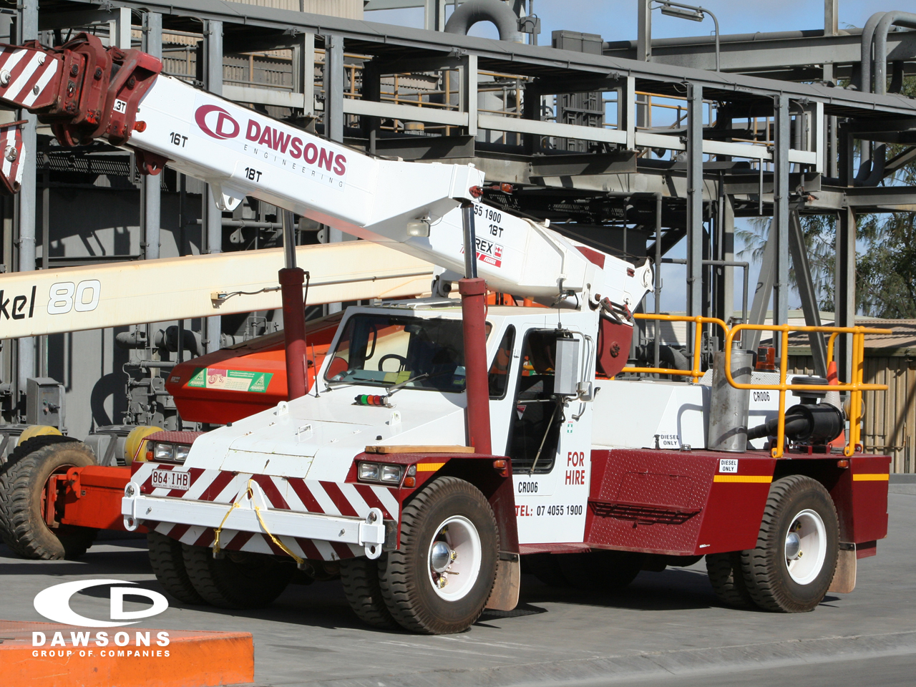
SERVICE CONTRACTS
What makes us different?
• Deliver value for money and prompt, excellent service – this is our underlying principle
• Seamlessly integrate our business with our clients to allow them to focus on what they do best
• We are able to provide organisation efficiencies for our clients and manage a fluctuating workload for our clients, we can do this by leveraging off all the Dawsons divisions
• We are committed to building long term relationships – regular meetings to review client expectations and work performances linked to KPIs

Slide 42
Example - Maintenance Contracts
Current Clients: Groote Eylandt Mine*
CleanCo Barron Gorge Power Station*
CleanCo Kareeya Power Station*
Mt Isa Mine*
Cannington Mine*
Century Mine*
Sun Metals*
Contract Types: * Short Term labour hire - monthly
* 2-5 year service maintenance contract
Notes:
Market Sectors

Slide 43
DEFENCE RECOGNISED SUPPLIER
Dawsons is a defence recognised supplier – Army, Navy, Air Force.
This logo is in recognition of Dawsons record of supply to the Australian Defence Organisation and the contribution Dawsons has made to the continued sustainability of the Australian Defence Force.
Notes:
Defence Recognised Supplier

Slide 44
TRAINING DIVISION
Dawsons Training Division was strategically set up to ensure that the Dawsons staff have the most up to date qualifications as required by our clients both on remote sites and within our workshops.
The location of the training facility is perfect:
• Adjacent to the Cairns workshop – simulated work environments and confined space set up
• Near the Cairns domestic and international airport, making it an attractive option for clients requiring induction training prior to fly in fly out projects.
• Flexibility. Our trainers can work remotely from client sites throughout Australia.
Notes:
Training Division 1

Slide 45
TRAINING DIVISION
Courses and Experience:
Our trainers have over 35 years experience in the mining industry throughout Australia, New Guinea and Fiji and have the support of external RTO’s and the Mining Industry Skills Centre, Brisbane.
Courses:
Dawsons provide a range of courses including:
• Generic Mine Induction - Metalliferous
• Confined Space Training
• S1, S2, S3 Site Safety and Health Representative Course
• Working at Heights
• Isolation and Tagging
Future scope to increase courses on offer.
Notes:
Training Division 2

Slide 46
SHUTDOWN SPECIALISTS
Dawsons Group of Companies are the remote area shutdown specialists.
The focus of the Dawsons Shutdown team is to maximise shutdown productivity whilst optimising safety performance - anywhere in Australia.
Our experience
Dawsons has been providing shut down support to the mining and process industries across Australia for over 21 years.
As a fully integrated heavy engineering and labour hire company, we are unique in our ability to provide end to end services.
Notes:
Shutdown Specialists 1

Slide 47
SHUTDOWN SPECIALISTS
What makes Dawsons Shutdown so successful?
There are 5 points of differentiation:-
1. Experience – lots of it!
With clients throughout Australia and a shutdown schedule averaging 500,000 man hours per annum
2. Relationships – long term value partnerships
We are committed to retaining and developing our current client base.
Our list of long term clients is testament to this.
3. Safe Crews
Safety is our priority – lives depend on it. Experienced crews.
Notes:
Shutdown Specialists 2

Slide 48
SHUTDOWN SPECIALISTS
4. End to End Solution
Dawsons can provide the complete Industrial Solution including fully integrated labour hire and heavy engineering options.
There is no “third party” involvement – no subcontractors. Our operation is seemless with crews directly employed by Dawsons.
5. Response Time
Dawsons are able to mobilise crews with short notice due to the size of our shut down workforce.
We have crews who work exclusively on shut down operations - they like variety and work pattern.
Notes:
Shutdown Specialists 3

Slide 49
MARKET SECTORS
Market Sectors in which Dawsons operate
Mining
Marine
Sugar
Defence
Government
Oil and gas
Power
Notes:
Market Sectors

Slide 50
Notes:
Our Vision

Slide 51
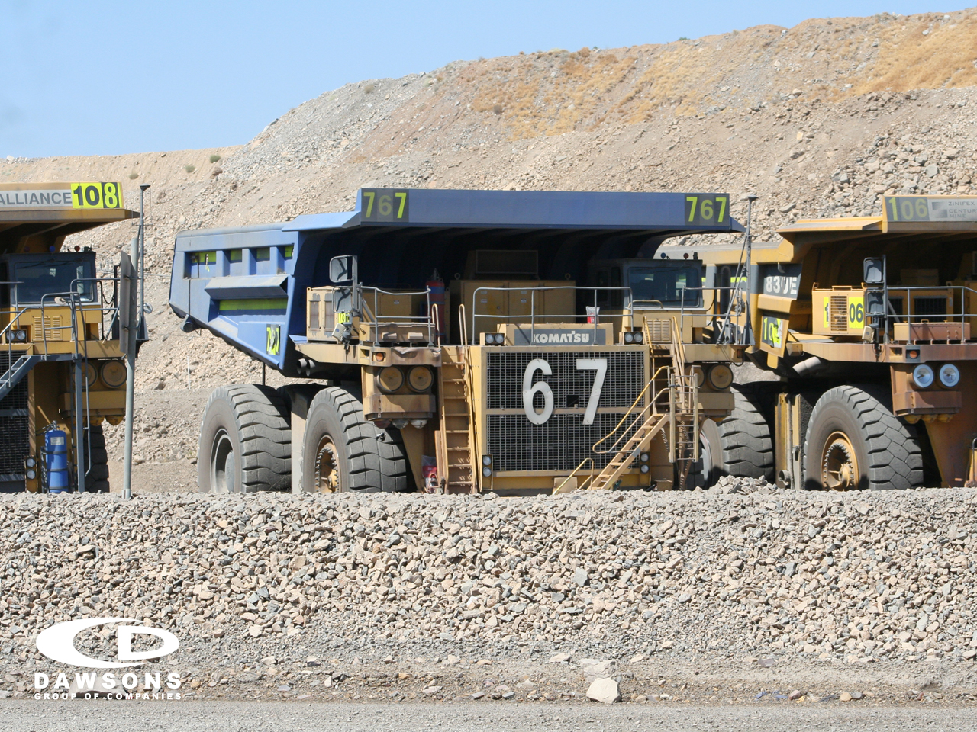
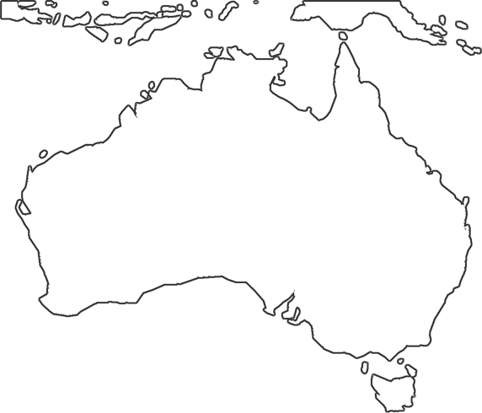
Notes:
Our Vision

